Slide 1



GIT & GITHUB
INSTRUCTOR: ZIA AHMAD
WWW.AISCIENCES.IO

Slide 2
GIT & GITHUB
PROJECT MANAGEMENT

Slide 3

OBJECTIVE
INTRO TO GIT & GITHUB
MANAGING LARGE CODES
PROJECT MANAGEMENT
COLLABORATION & CODE SHARING

Slide 4

CREATING ACCOUNT

Slide 5

COMMIT
Make Changes
Add those Changes
Commit

Slide 6



INSTALLATIONS
git --version
Terminal
Git bash
Any code editor / IDE/ VS Code / Pycharm / ...

Slide 7


CONFIGURATION
git config --global user.name
git config --global user.email
git config --list

Slide 8

MISSION:

Slide 9


CLONE
git clone [link]
Local
Global
Laptop/PC
Github

Slide 10


CD COMMAND
CD [Sub-Folder Name]
Main Folder
Sub-Folder

Slide 11




GIT STATUS TYPES
Untracked
Modified
Unmodified
Staged
No Change
New file added
Changes made in existing file
After git add

Slide 12


ADD/COMMIT
git add [file name]
git add .
git commit -m “A message with a purpose”

Slide 13


GIT PUSH
git push origin main
Local
Remote
Updated code

Slide 14

Create Repo
Clone
HIERARCHY
OF
COMMANDS
Make Changes
git add
git commit
git push

Slide 15


LOCAL REMOTE
Git init
Git remote add origin <>
Git remote -v
git push origin main
Git branch
Git branch -m main

Slide 16



GIT BRANCH

Slide 17

BRANCHES

Slide 18

BRANCHES
git branch
git branch -M <new name>
git checkout -b <new branch name>
git checkout <branch name>
git checkout -d <delete branch name>

Slide 19

MERGING

Slide 20

MERGING
Local
Remote
git diff <branch name>
Pull Request
git merge <branch name>

Slide 21


PULL REQUEST

Slide 22
GIT PUSH
git push origin main
Local
Remote
Updated code

Slide 23
GIT PULL
git pull origin main
Local
Remote
Updated code

Slide 24

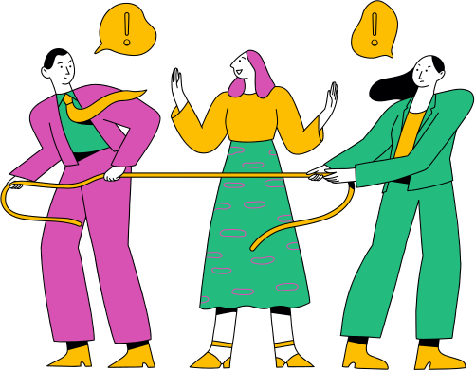
CONFLICT
When the there is a difference of code at exactly same places

Slide 25
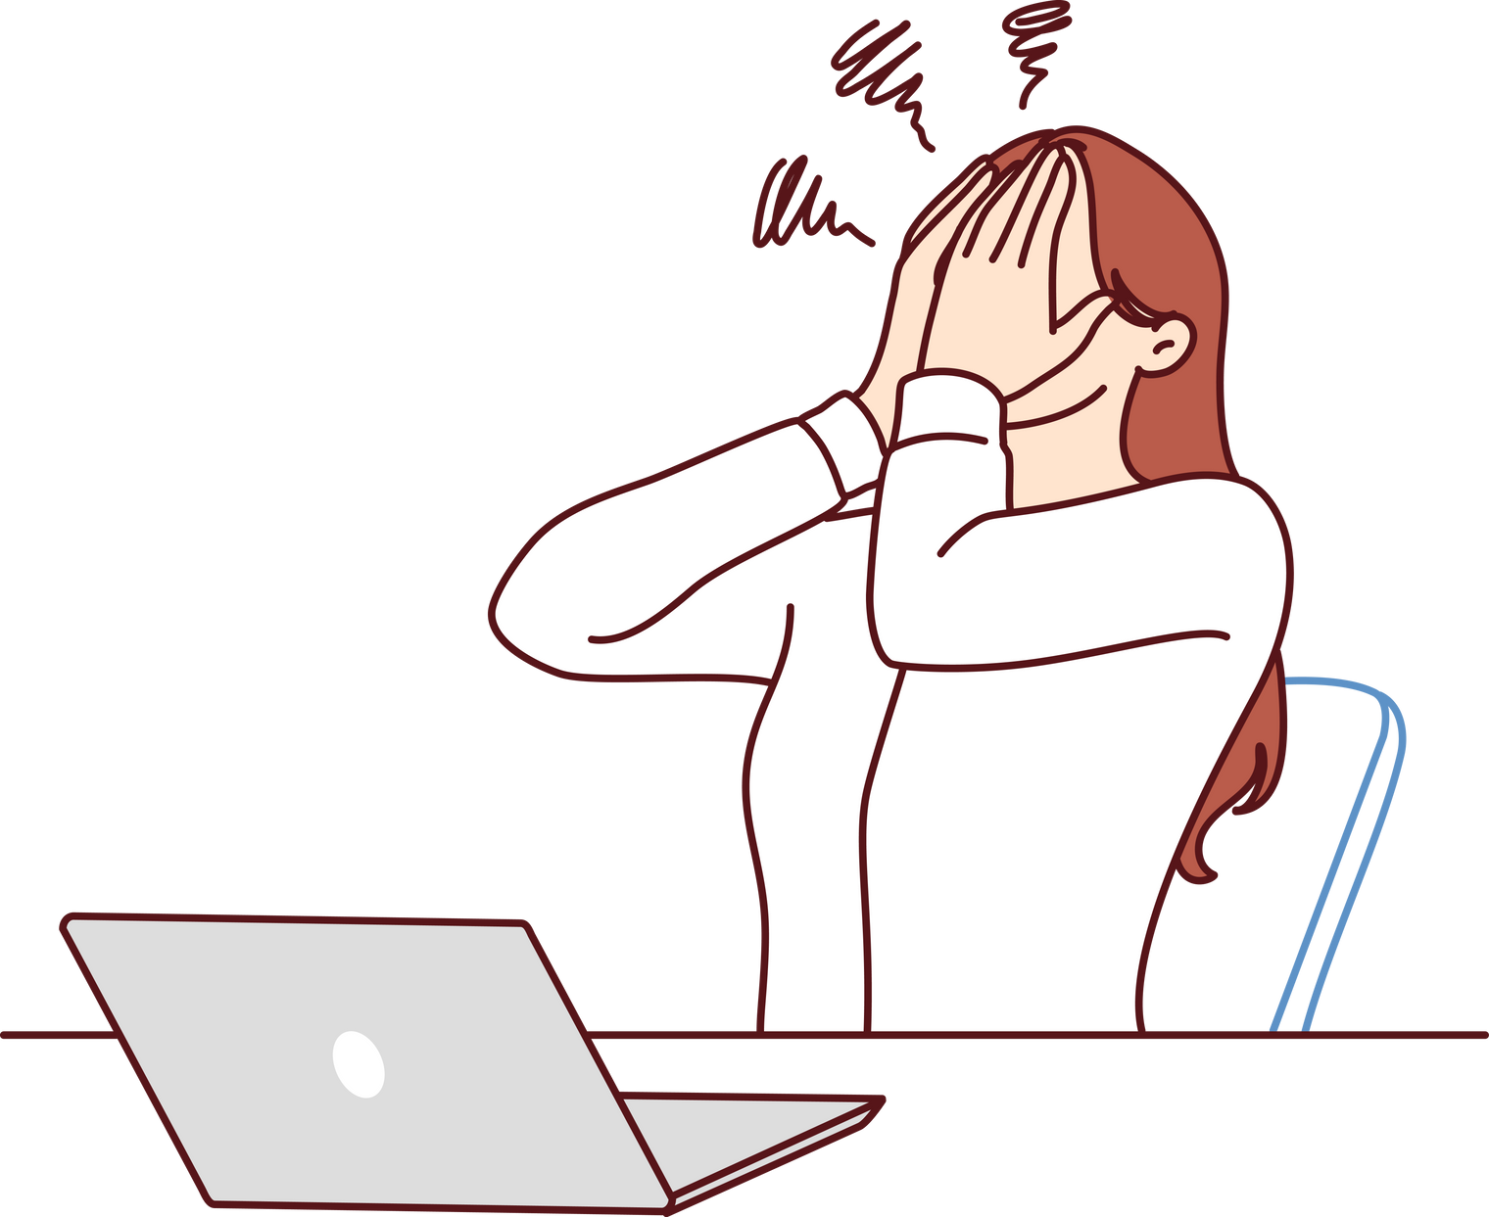
Undo

Slide 26

UNDO BEFORE ADD/COMMIT
git restore -- <filename>
git restore -- .

Slide 27
UNDO
AFTER ADD &
BEFOR COMMIT
git reset <filename>
git reset

Slide 28
UNDO
AFTER ADD & COMMIT
git reset HEAD ~1
git reset <commit hash>

Slide 29


HEAD
Current Commit
git reset HEAD ~1
3
2
1
1

Slide 30

FORK
Copy of an existing repository in which the new owner disconnects the codebase from previous committers

Slide 31
CONTACT US
contact@aisciences.io
www.aisciences.io
@AISciencesLearn

